Slide 1

A Usability Evaluation of the Tor Anonymity Network
By Gregory Norcie

Slide 2

What is Tor?
An onion routing protocol
originally sponsored by the US Naval Research Laboratory
From 2004 to 2006 was supported by EFF
Since 2006 has been it’s own 501(c)(3) nonprofit
Image courtesy indymedia.de

Slide 3
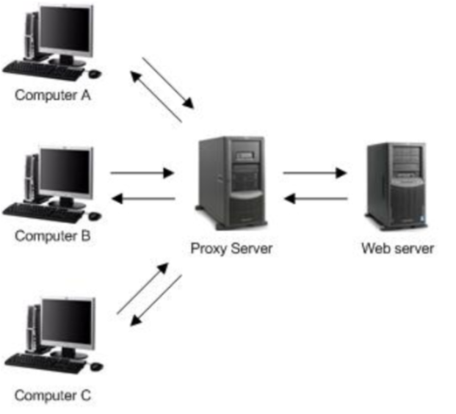
Q: What is an onion routing protocol?
A: Like a proxy. But better.

Slide 4
So How Does an Onion Routing Protocol Work?
The user creates a “circuit” leading to their destination.
At each hop, the node “unwraps” a layer from the packet via symmetric keys, revealing the next destination.
Full technical details: http://www.torproject.org/tor-design.pdf

Slide 5
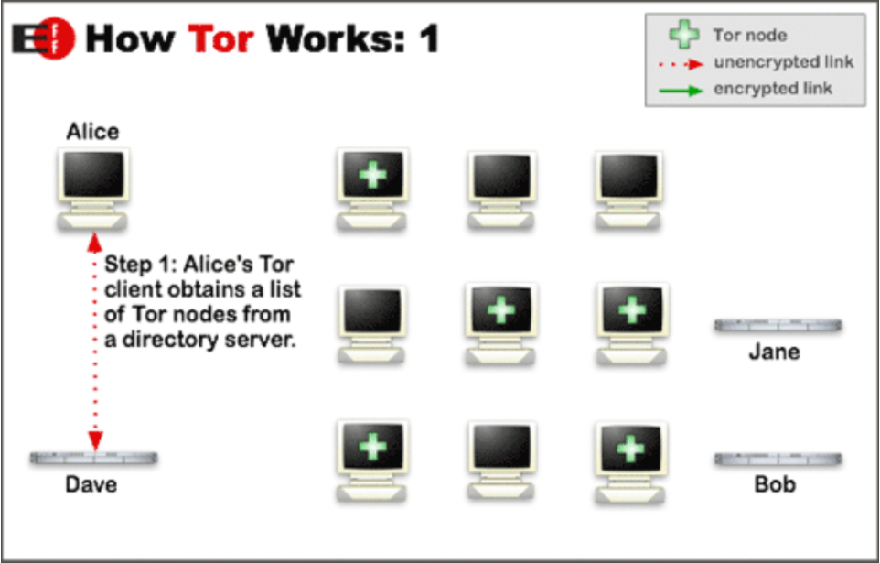
Image courtesy torproject.org

Slide 6
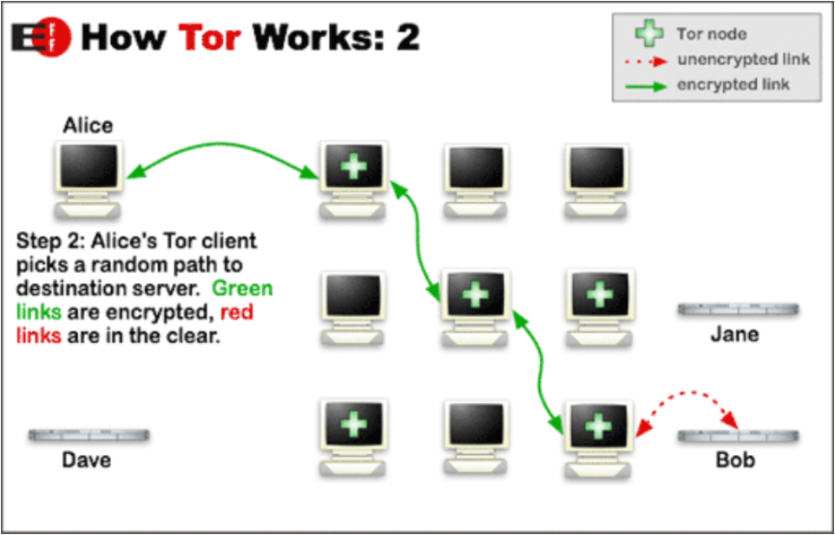
Image courtesy torproject.org

Slide 7
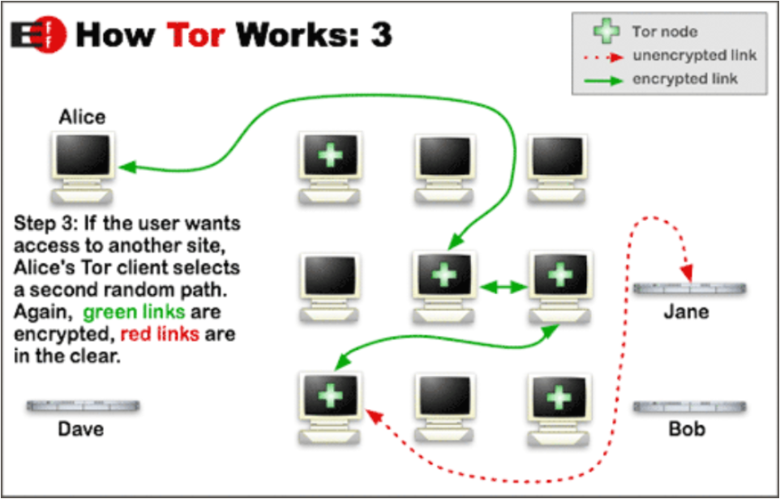
Image courtesy torproject.org

Slide 8
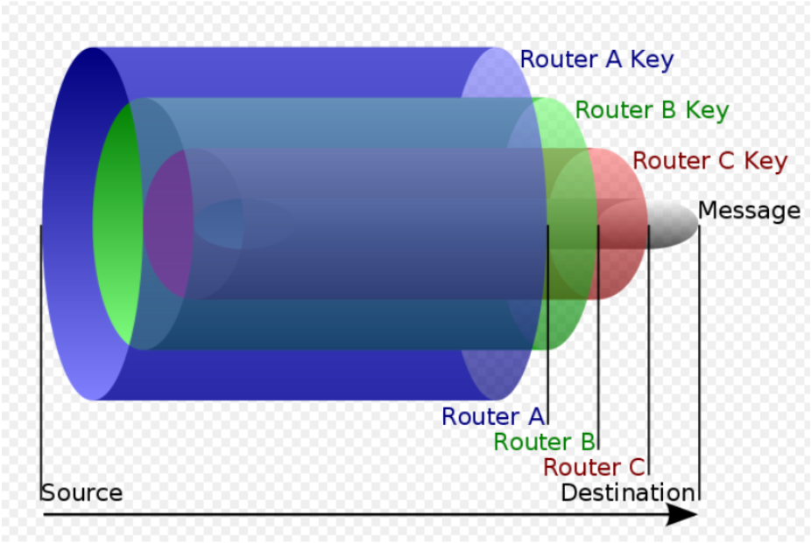
Photo courtesy Wikimedia Commons

Slide 9
So Why Use Tor?
Law enforcement uses Tor to visit target websites without leaving government IP addresses in their web log, and for security during sting operations.
Whistleblowers use Tor to anonymously contact media organizations
Dissidents use Tor to get outside information in oppresive regimes.

Slide 10
Real Life Example: 2009 Iranian Presidential Election
All Western Media deported or sequestered in hotels
Internet Filtering of popular social networking sites (twitter, facebook, youtube, etc)
US State Dept asks twitter to delay maintenance
((http://www.nytimes.com/2009/06/17/world/middleeast/17media.html?_r=1)

Slide 11

Case in point: The Death of Neda Agha-Soltan
Video of unarmed protester fatally shot by Basij militia
Video uploaded to youtube, shared via twitter.
#neda becomes trending topic on twitter
Photo Courtesy Wikimedia Commons

Slide 12
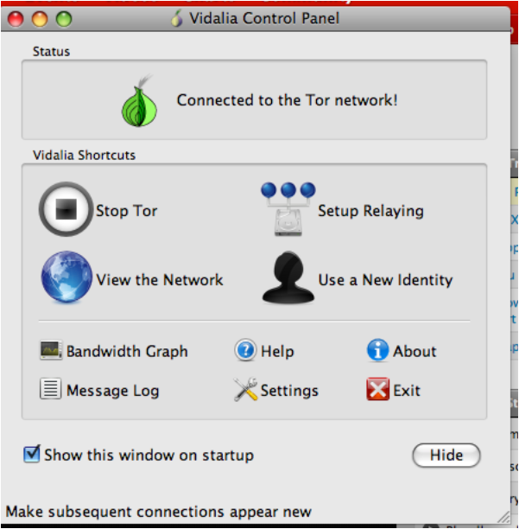
So How Do I Use Tor?
Option 1:
Command line
Option 2: GUI
We of course, want to use option 2.
Example of Tor controlled via GUI: Torbutton

Slide 13
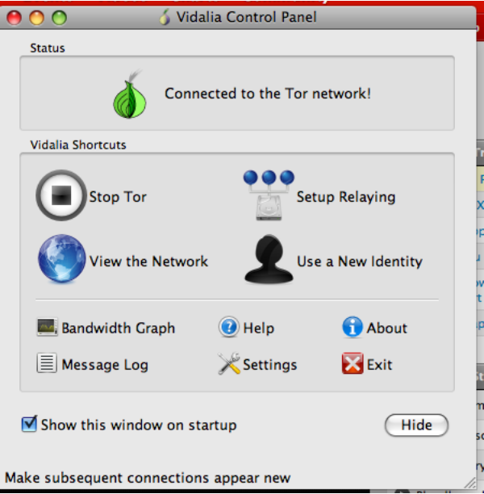

Slide 14
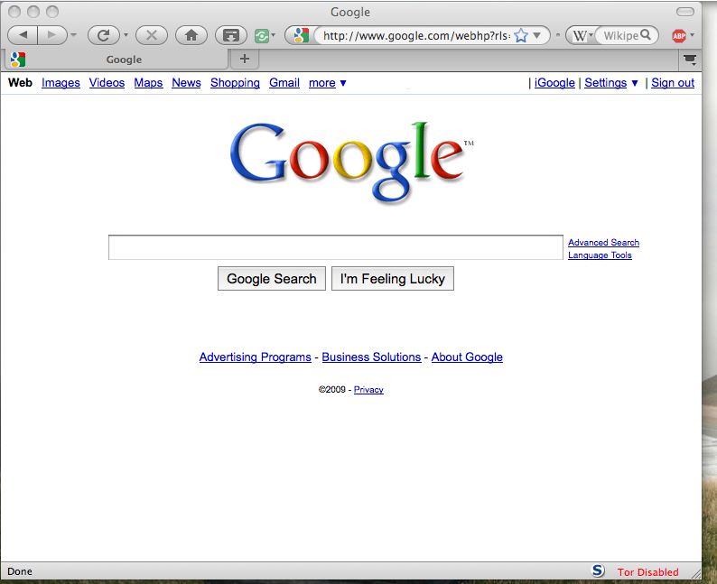

Slide 15
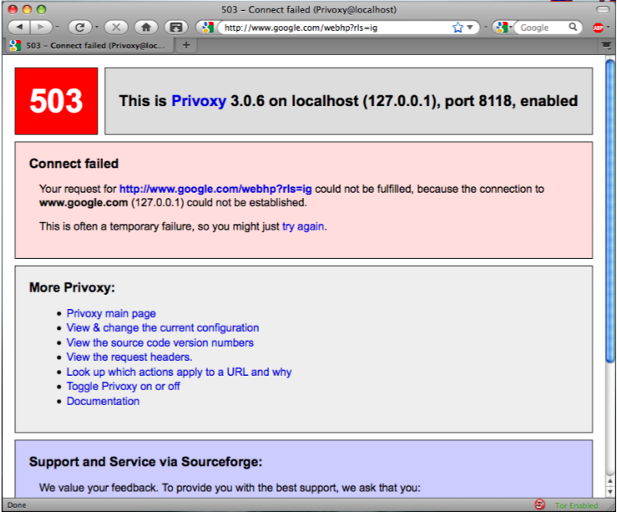
Torbutton: Designed for Usability

Slide 16
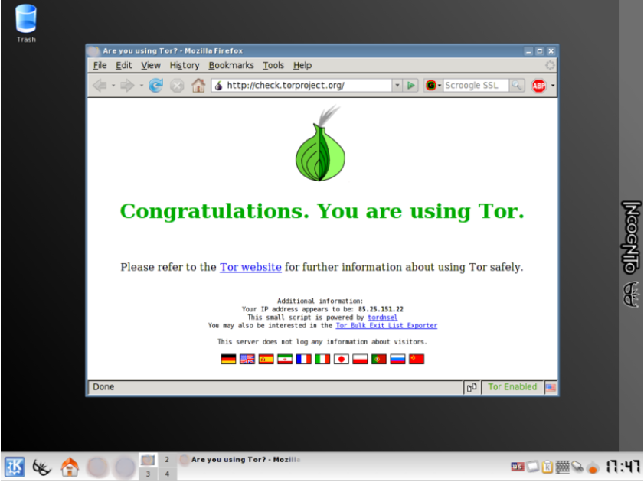
Photo courtesy Wikimedia Commons

Slide 17

Tor is Not Perfect

Slide 18

The 3 Traditional Threats to Tor's Security:
DNS Leaks
Traffic Analysis
Malicious Exit Nodes

Slide 19
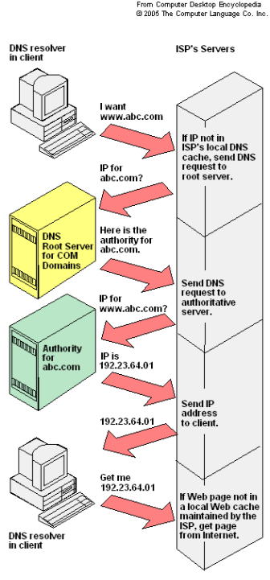
Threat 1: DNS Leaks
DNS requests not sent through Tor network by default
Attacker could see what websites are being visited
external software such as Foxyproxy and Privoxy can be used to route DNS requests through tor network, but this is _not_ default behavior

Slide 20

Threat 2: Traffic Analysis
"Traffic-analysis is extracting and inferring information from network meta-data, including the volumes and timing of network packets, as well as the visible network addresses they are originating from and destined for."
Tor is a low latency network, and thus is vulnerable to an attacker who can see both ends of a connection
Further reading: Low Cost Traffic Analysis of Tor: (http://www.cl.cam.ac.uk/~sjm217/papers/oakland05torta.pdf)

Slide 21

Threat 3: Rogue Exit Nodes
Traffic going over Tor is not encrypted, just anonymous
Malicious exit node can observe traffic
Swedish researcher Dan Egerstad obtained emails from embassies belonging to Australia, Japan, Iran, India and Russia, publishes them on the net.
Sydney Morning Herald called it “hack of the year” in interview with Egerstad

Slide 22
Additional Reading
Tor design document: https://git.torproject.org/checkout/tor/master/doc/design-paper/tor-design.html
Usability of Anonymous web browsing: an examination of Tor Interfaces and deployability Clark, J., van Oorschot, P. C., and Adams, C. 2007. (http://cups.cs.cmu.edu/soups/2007/proceedings/p41_clark.pdf)
Article in Wired on Malicious exit nodes: http://www.wired.com/politics/security/news/2007/09/embassy_hacks?currentPage=1
Dan Egerstad Interview: (One of first to widely publish on malicious exit nodes):
http://www.smh.com.au/news/security/the-hack-of-the-year/2007/11/12/1194766589522.html?page=fullpage#contentSwap1
Low-Cost Trafﬁc Analysis of Tor: http://www.cl.cam.ac.uk/users/sjm217/papers/oakland05torta.pdf
Why Tor is Slow and What We're Doing About It: https://svn.torproject.org/svn/tor/trunk/doc/roadmaps/2009-03-11-performance.pdf

Slide 23
Something to Think About:
"A hard-to-use system has fewer users — and because anonymity systems hide users among users, a system with fewer users provides less anonymity. Usability is thus not only a convenience: it is a security requirement"
-Tor Design Document

Slide 24

#1 Tor Usability Issue: TOR IS SLOW
Example: TCP backoff slows down every circuit at once.
“Tor combines all the circuits going between two Tor relays into a single TCP connection.
Smart approach in terms of anonymity, since putting all circuits on the same connection prevents an observer from learning which packets correspond to which circuit.
Bad idea in terms of performance, since TCP’s backoff mechanism only has one option when that connections sending too many bytes: slow it down, and thus slow down all the circuits going across it.
This is only one subpart of one section of a 27 page paper entitled “Why Tor is Slow and What We're Doing About It”.
Photo courtesy Wikimedia Commons

